Slide 1

IOT Project
Nicolas GUEGUEN– 6218000229
Vladislav ZOBOV– 6218000239
姚苏丹 - 2018218081
Grégoire RENARD- 6218000234
Notes:
As we couldn’t do real IOT because of server issues, we tried our best to simulate a similar environment thanks to the computer, we are going ot deal with it now

Slide 2
Summary
Project presentation
Why ?
Sensors Used / technologie Used
Problems encountered
How it works ?
Conclusion

Slide 3
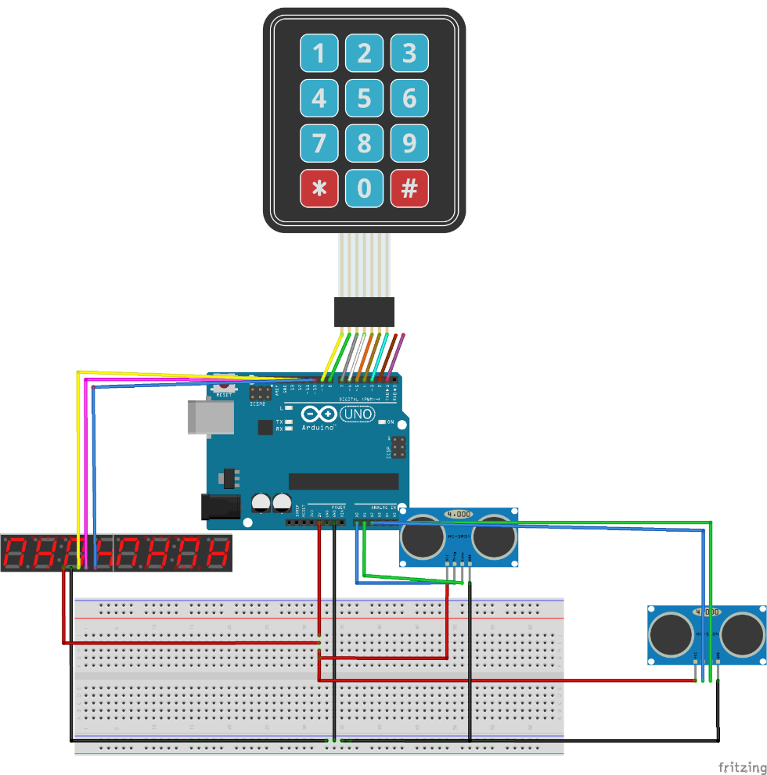
Project presentation
A new way and easy to manage employee’s entries and departures within a firm
Notes:
Our project consisted in an innovative and simple way to help a firm manage its employees.
Thus, when someone enters the building, they are noticed and have to type their personal code so that the admin checks who they are, when they have arrived and the system greets them. They can enter.
Then, when one goes out, they are also noticed, have to type their personal code, the admin checks out again who they are, know how long they have worked and greet them.

Slide 4
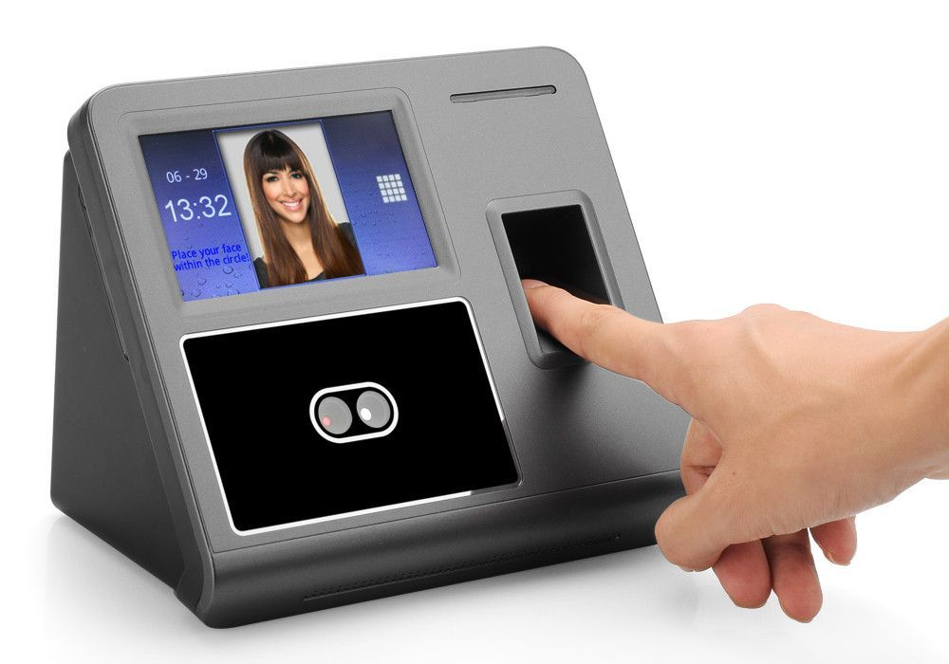
Why ?
Presence system
Check Point System
Alarm System
Notes:
Then, you’d ask what the goal of out project is : It intends to simplify and modernize people’s presence’s checkouts within a firm, as well as greeting them and adding additional safety.
It implies three parts : a presence system, a Check Point System and an alarm system
Btw, there is a point we didn’t mention earlier, the « alarm system » that we are going to deal with in the next slide

Slide 5
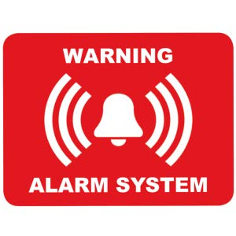
About the Alarm system
When the admin enters the building , the safety alarm gets over
Once the admin leaves the building, it gets locked and the alarm on
Notes:
Well, our alarm system works this way :
- When the admin enters the building , the safety alarm gets over
Once the admin leaves the building, it gets locked and the alarm on
It has been designed to increased the safety

Slide 6

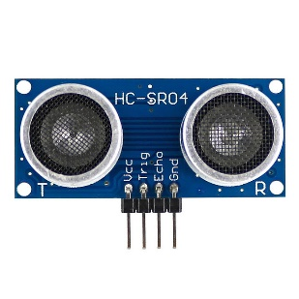
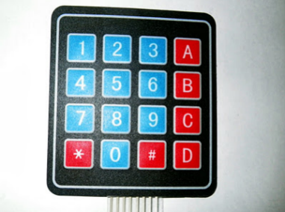
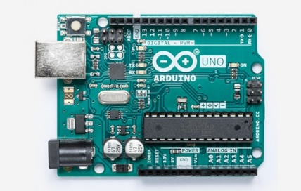

Sensor Used / technologie Used
We use 2 ultrasonic sensors, a pannel control sensor, one « 8 digit display » and the arduino Uno
One computer (to simulate IOT platform) with Console Application in c# to send email and display results.
Notes:
This is the list of the material we used for our project :
…
…
Our computer is used to replace the LED screen we intended to use but we actually lacked of port on our Arduino card.
As said earlier, we can’t use the cloud to make a « real » IOT project so our program sends an e-mail to the administrator each time someone enters or goes out to « simulate » cloud use

Slide 7
Problems encountered
Scarcity of ports on the Arduino card
Malfunction of our 8 digit display
Notes:
Actually, our inital project was to use a LED screen or to replace our 8 digit display for a 4 digit one, but they both required more ports than we had left after using the the panel control and the 2 ultrasonic sensors
We also had difficulties with our 8 digit display since it malfunctionned. I mean, the whole code was written but we didn’t achieve to have it work properly so we replaced it by additional codes within the computer.

Slide 8
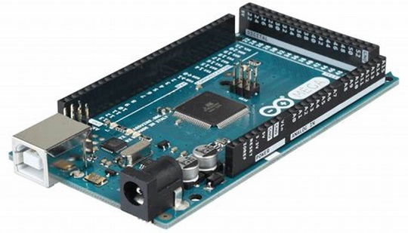


How it works ?
Notes:
Quand l’utilisateur passe devant le capteur 1 (entrer) l’arduino va activer le panel control pour obtenir un mot de passe 10s de delai pour annuler l’activation (se relance si l’utilisateur appuie sur une touche) et valide avec la touche # ou alors il peut reset le mdp taper. Si le mot de passe est faux l’ecran affiche wrong ID si il est bon welcome
Quand l’utilisateur passe devant le capteur 2 (sortie) l’arduino active le panel contrôle pour savoir si l’utilisateur qui sort veut mettre l’alarme ou pas, si le mdp admin est saisie l’alarme est ready. Après l’activation juste l’admin peut rentrer en mettant sont mdp sinon intrusion ,sinon just goodbye
Les mail sont envoyer en cas d’intrusion et d’arriver d’un utilisateur.
When the user is going in front of the Ultrasonic sensor 1 (entrance one), the arduino card is going to activate the panel control to obtain a 10s delay to type their password before it is cancelled (btw, these 10 seconds are refreshed once a button is typed), then they validate with # button.
Then, if the password is incorrect, the screen will display « WRONG » or « Welcome » if it’s right.
When the user is going in front of the Ultrasonic sensor 2 (exit one), the arduino card is activated

Slide 9
Conclusion
We managed to create an arduino project able to meet our needs of telling employees’ attendance, the amount of work they have worked and the alarm
We learned a lot about IOT and arduino through an interesting project
Notes:
So, we managed to create an arduino project able to meet our needs of telling employees’ attendance, the amount of work they have worked and the alarm
We learned a lot during this project:
The application of Arduino in an IoT project, implementation of different kinds of captors we worked with, extract and work with data we collect through our captors.
It’s a good experience for us to work on the project with the IoT purpose, we learned a lot of new things and reinforced our base knowledge.

Slide 10

End

